Slide 1

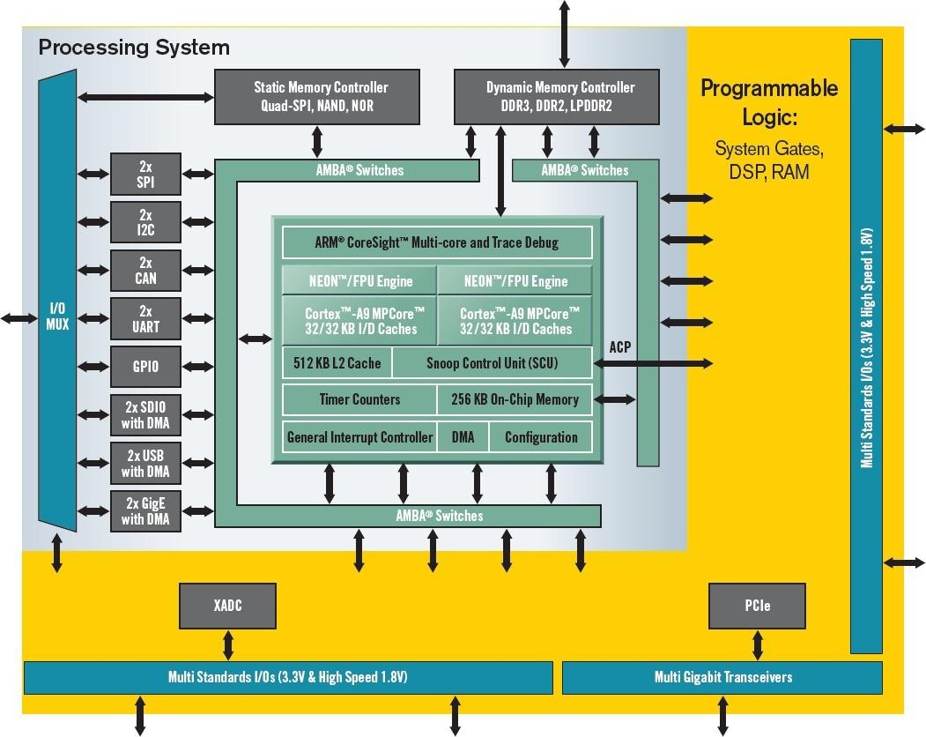
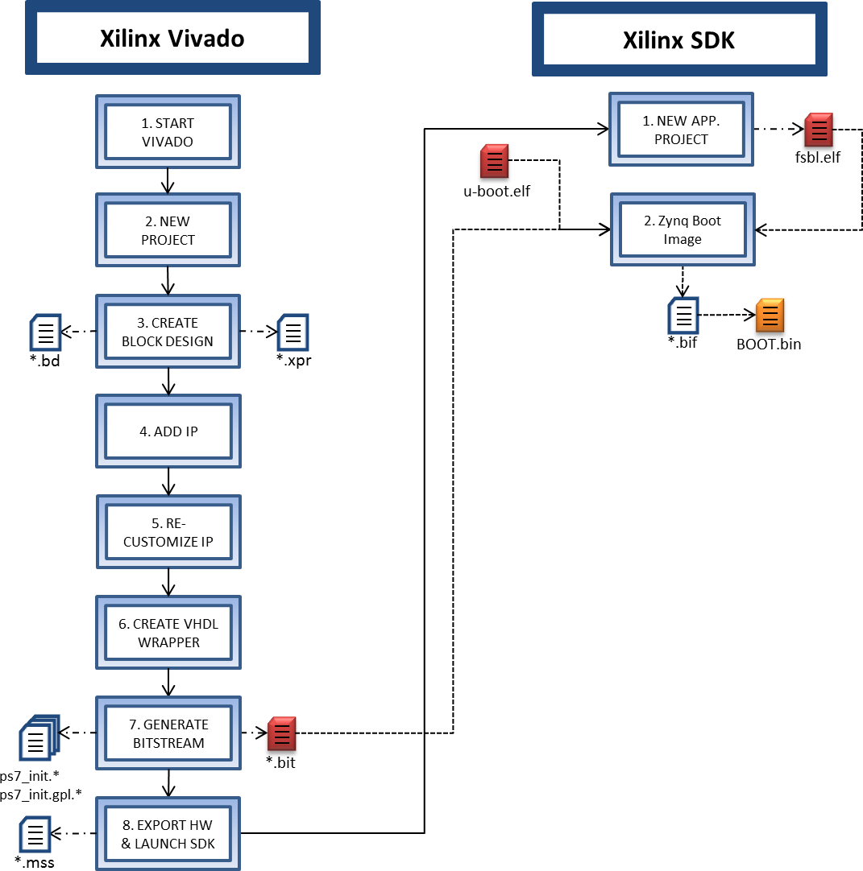
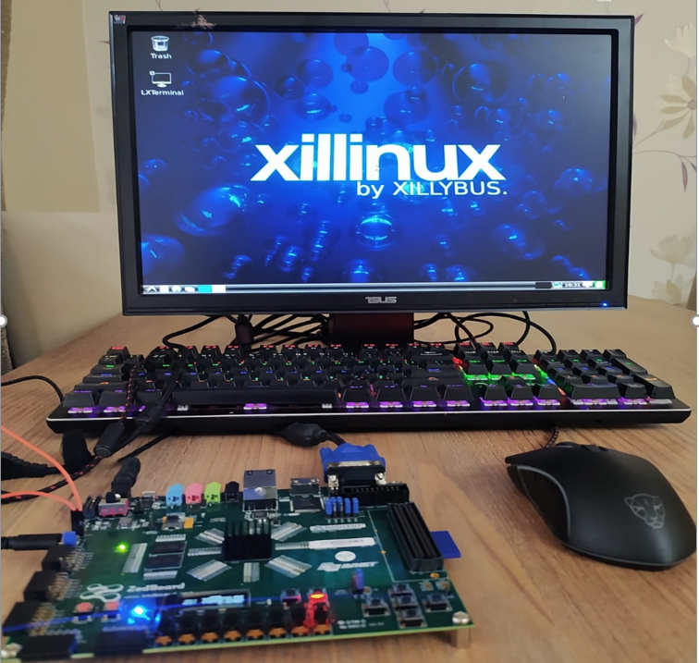
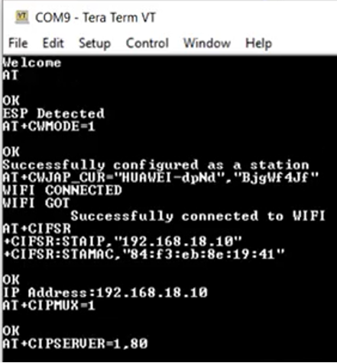
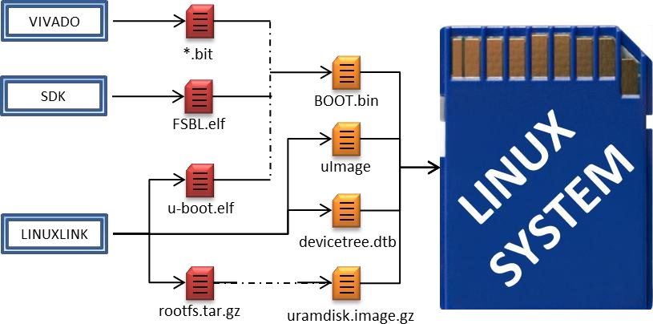
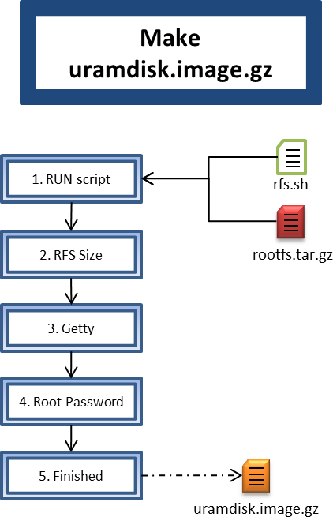
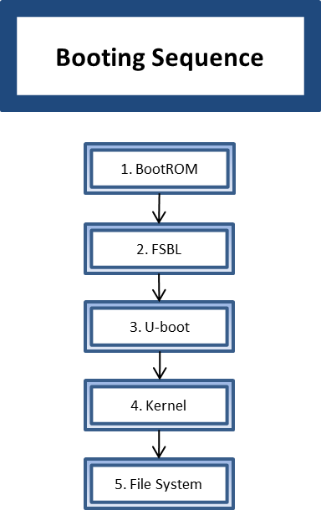
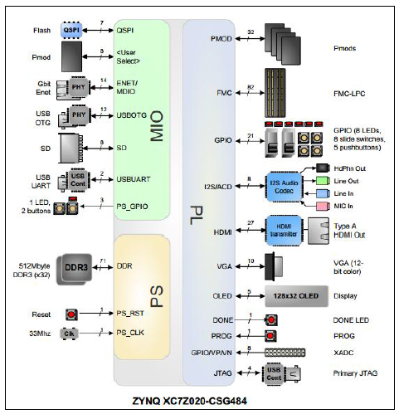
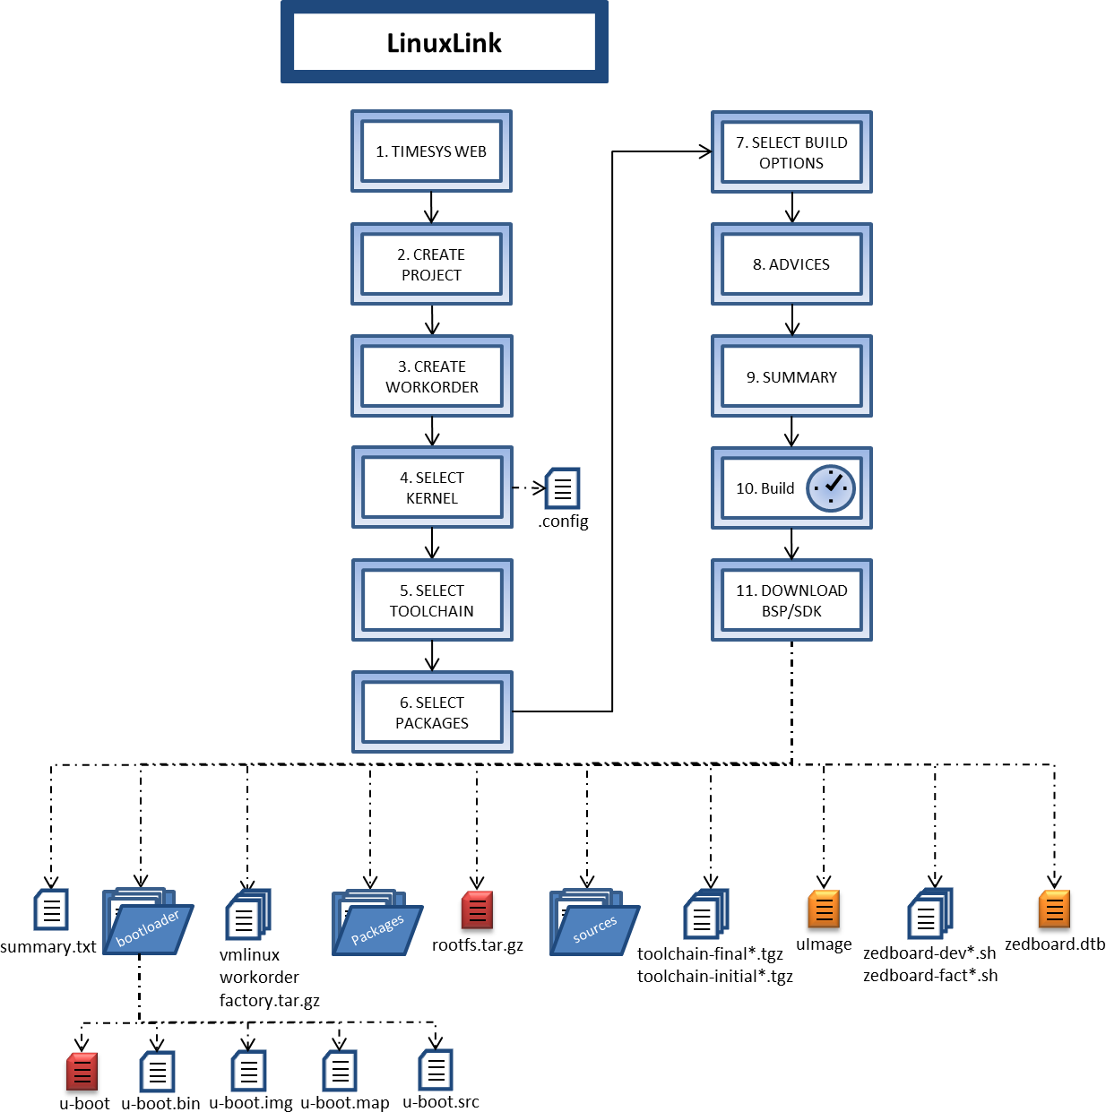
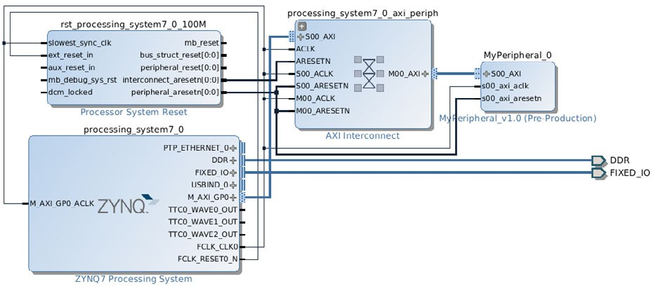
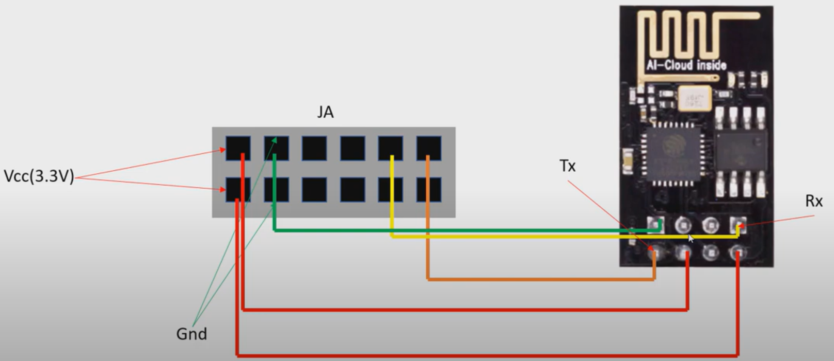
Driver development for Zedboard peripherals and their integration into the SOC LINUX operating system and
Connecting ZedBoard with Wifi through ESP8266
Fatmanur Özel- Aleyna Karapınar
Electronic and Communication Engineering Department, Cankaya University
Abstract
The final achievement of this project is to develop and implement a custom and Embedded Linux Operating System (OS) integrated with a specific PL peripheral. This OS will be developed on ZedBoard (Zynq Evaluation & Development Board) development kit, Xilinx's Zynq-7000 All Programmable System on Chip which contains a dual core ARM Cortex-A9 and a 7 Series FPGA Artix-7. [1] After performing these operations in the first term, we continued our second term project by providing communication between Zedboard and ESP8266 Wifi module.
Figure 3 – Zynq 7000 functional blocks
Custom Distribution
In this chapter an embedded system will be developed, from the beginning to the system booting. Also a test user program and a debugging will be shown.
The building process for a minimal embedded system is divided in four main steps:
The first step includes the selection of the kernel, the device tree blob, the root files system and the u-boot files.
The second step includes the creation of the bitstream and the Processing System configuration. Also the FSBL and BOOT files will be generated.
The third step describes the additional actions needed to boot the system correctly.
The last step prepares the host for booting the system and boots it.
Figure 4 describes the complete process.
Figure 4 – Custom Distribution Process
Figure 5 shows the main steps of the Linuxlink process. The files in red are needed to create the final files. The files in orange will be copied into the SD card.
Figure 5 – Linuxlink Design Flow
Figure 6 is described the de main steps of the design flow for Vivado and SDK software. Files represented in red are going to be used to generate an orange file that is one of the main files for booting the system. Notice that u-boot.elf was generated with Linuxlink.
Figure 6 – Vivado & SDK Design Flow
The script execution
At this point there are already three files ready to copy into the SD card, only one remains, this is the “uramdisk.image.gz” or the RFS
The file generated by Linuxlink cannot operate as RFS so it needs to be converted. Additionally some changes in the RFS could be done. This is shown in Figure 7.
Be sure that “rootfs.tar.gz” and “rfs.sh” are in the same folder. Run the script with “./rfs.sh”.
Set the RFS size. It could not be bigger than 10MB for this example.
Decide if a “getty” is needed. Getty is an utility that prompts a message at the end of the booting process to ask the user for a login.
Set a root password.
Make every additional changes needed for the system and at the end finish the conversion. Finally, “uramdisk.image.gz” file has been created.
Figure 7 – Uramdisk build Figure 8 – Booting Sequence
The block diagram created to add an operating system to Zedboard is shown in below.
The connection between ESP8266 WIFI module and Zedboard is shown in below.
Results and Conclusions
In this project, we carried out studies in the field of FPGA. First of all, we installed the operating system (Linux) on the Zedboard card (Figure 11). After reaching the targeted part, we connected the ESP8266 module and our Zedboard card, transferred data via UART and observed the data (Figure 12).
Figure 11 Figure 12
Introduction
Nowadays Embedded System based applications are increasing. Its very usual to find them. İnside a television, a refrigerator, a car or even inside a plane. These things are very different but not the tools to develop the Embedded System. The best characteristic of an Embedded System is its versatility because with the same computer and the same tools it is possible to develop systems completely different. The Embedded Systems have the same advantages of software tools in the electronic systems field, allowing the designer to develop specific applications independently of the hardware architecture in an easy way.
There are many options to build an Embedded System regarding to the operating system. Some of those options are Android OS, Embedded Windows or Embedded Linux. The Embedded Linux is the mostly used in the professional environment for that reason it will be the option chosen to develop the example of this document.
Another topic is mentioned that UART. In UART communication, two UARTs communicate directly with each other. The transmitting UART converts parallel data from a controlling device like a CPU into serial form, transmits it in serial to the receiving UART, which then converts the serial data back into parallel data for the receiving device. Only two wires are needed to transmit data between two UARTs.
Literature cited
Article Reference: Article Reference: Ginés Hidalgo Martínez, Implementing an Embedded Linux System in Xilinx Zynq, 2013/2014
Article Reference: Miguel del Castillo Campos, Embedded Linux Integration Using Linuxlink Tool and Peripheral Driver Development for Zedboard, Departamento de Ingeniería Telemática y Electrónica, 2008
Website Reference: https://www.circuitbasics.com/basics-uart-communication/
Materials and methods
Zedboard was created to be a community development platform evaluation and development board based on Xilinx Zynq-7000 All Programmable System on Chip. Combining a dual Cortex- A9 Processing System with 85000 7-Series Programmable Logic cells, the board allows the designer to implement many different applications and use many different connections. Figure 2 shows the peripherals that are included on Zedboard and a block diagram that explains how they are inter-connected.
Figure 2 – Zedboard Block Diagram
Xilinx Zynq-7000 Soc
The heart of the Zedboard is a Xilinx All Programmable SoC architecture. This Soc integrates a dual-core ARM Cortex-A9 MPCore based Processing System (PS) and a Xilinx Programmable Logic (PL) in a single chip. The PS includes on-chip memory, external memory interfaces and a set of I/O peripherals.
Figure 3 illustrates the functional blocks of the Zynq-7000 AP SoC. PS and PL are on separated power domains, allowing the user to power down the PL management.
The processors in the PS usually boot first. The PL could be configured as part of the boot process or configured after. The PL can be completely reconfigured or used with partial, dynamic reconfiguration (PR). PR allows the configuration of a part of the PL.
Acknowledgments
We would like to thank our supervisor Orhan GAZI, for his guidance and help throughout the project. We further like to thank electronic and communication engineer Fatih GENC for the preparation of experimental setup.
Photo

